Slide 1
ICS 2305: Data Communication
:Cabling-Making connections with Cat5
Lab Work

Slide 2
Overview
What cable types are available?
How do cables work?
How are cables used in networking?
How are connections made?

Slide 3
Learning Objectives
List common cable types used in networking
Describe how UTP cables are made
Explain how UTP cables are used in Ethernet networks
Demonstrate the ability to make a working patch cable
Name the two wiring standards used for wired Ethernet networks and their uses

Slide 4
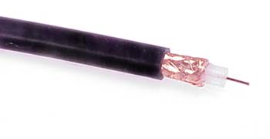
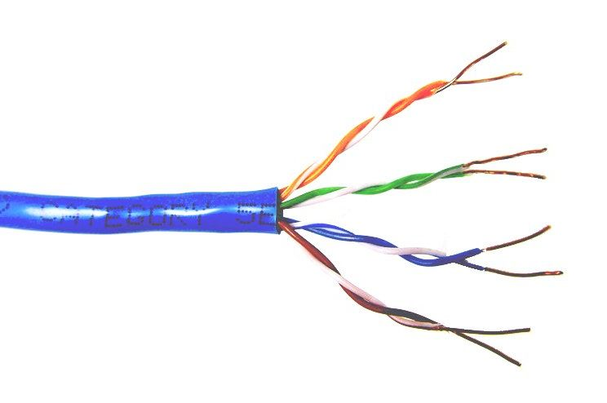
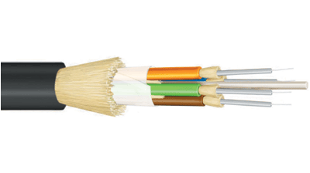
Common network cable types
Coaxial cable
Unshielded twisted pair
Fiber optic

Slide 5
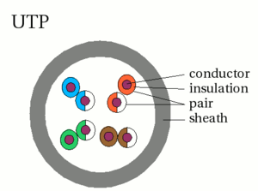
UTP characteristics
Unshielded
Twisted (why?) pairs of insulated conductors
Covered by
insulating sheath

Slide 6
UTP categories
Category 1 | Voice only (Telephone)
Category 2 | Data to 4 Mbps (Localtalk)
Category 3 | Data to 10Mbps (Ethernet)
Category 4 | Data to 20Mbps (Token ring)
Category 5 Category 5e | Data to 100Mbps (Fast Ethernet) Data to 1000Mbps (Gigabit Ethernet)
Category 6 | Data to 2500Mbps (Gigabit Ethernet)

Slide 7
Cat5e cable
1000Mbps data capacity
For runs of up to 90 meters
Solid core cable ideal for structural installations (PVC or Plenum)
Stranded cable ideal for patch cables
Terminated with RJ-45 connectors

Slide 8
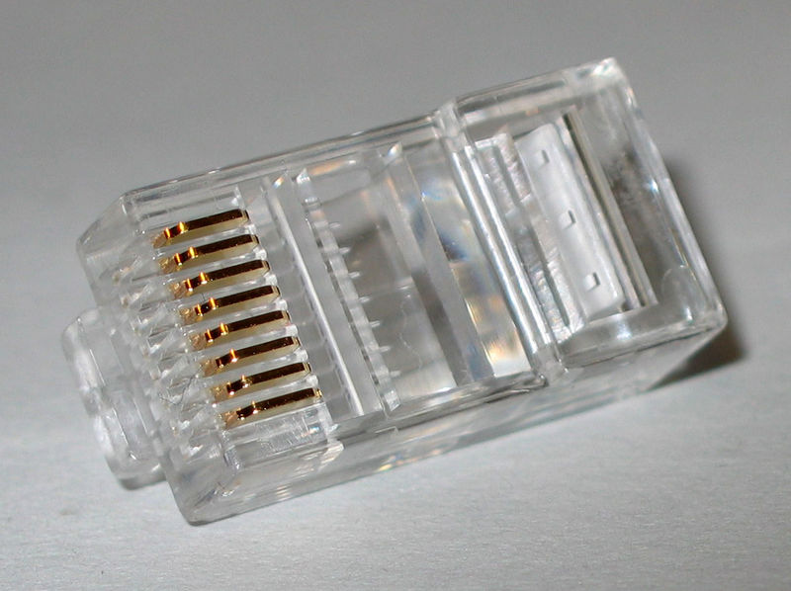
RJ45 connector

Slide 9

Making connections - Tools
Cat5e cable
RJ45 connectors
Cable stripper
Scissors
Crimping tool

Slide 10
Cabling Concepts
Straight though cables or also known as patch cables
Wiring sequence is B-B o/w O g/w B b/w G br BR on both ends
Connects like devices
Cross-over cables: A-B sequence i.e g G o B b O br BR to B as above
The difference in the cables are the way the wires
are connected within the RJ45.

Slide 11
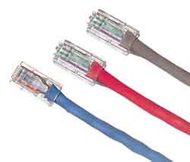
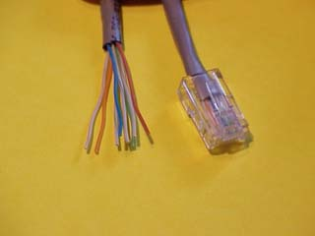
Basics of Networking
Typical Crossover Cable
Wiring: 1-3 White/Orange 2-6 Orange 3-1 White/Green 4-4 Blue 5-5 White/Blue
6-2 Green 7-7 White/Brown 8-8 Brown

Slide 12
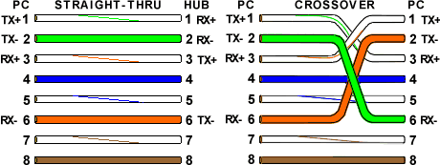
Wiring sequence

Slide 13
Basics of Networking
COMMUNICATION CHANNELS
TWISTED SHIELDED PAIR – USED IN PHONE LINES, NETWORKS
UNSHIELDED TWISTED PAIR “ “ “ “
COAXIAL CABLE – USED IN CABLEVISION GREAT FOR VIDEO
FIBRE OPTIC CABLES - USES LIGHT TO CARRY SIGNAL BUT
HARD TO WORK WITH AND LOOSES SIGNAL OVER LONGER
DISTANCES

Slide 14
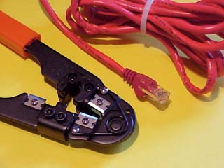
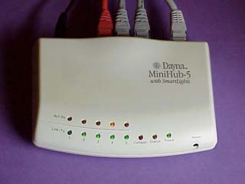
Tools
Crimping Tool
Hub

Slide 15
Making connections - Steps
Strip cable end
Untwist wire ends
Arrange wires
Trim wires to size
Attach connector
Check
Crimp
Test

Slide 16
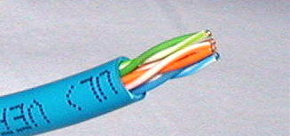
Step 1 – Strip cable end
Strip 1 – 1½” of insulating sheath
Avoid cutting into conductor insulation

Slide 17
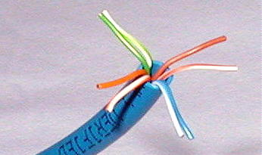
Step 2 – Untwist wire ends
Sort wires by insulation colors

Slide 18
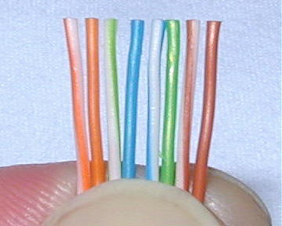
Step 3 – Arrange wires
TIA/EIA 568A: GW-G OW-Bl BlW-O BrW-Br
TIA/EIA 568B: OW-O GW-Bl BlW-G BrW-Br

Slide 19
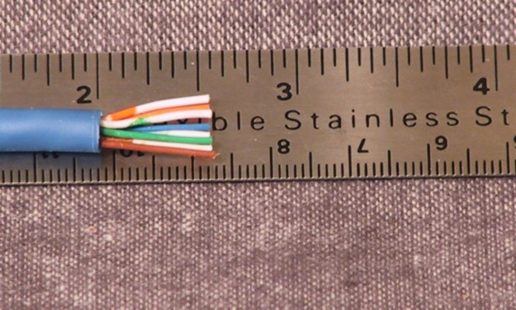
Step 4 – Trim wires to size
Trim all wires evenly
Leave about ½” of wires exposed

Slide 20
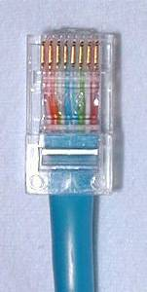
Step 5 – Attach connector
Maintain wire order, left-to-right, with RJ45 tab facing downward

Slide 21
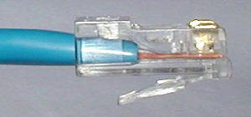
Step 6 - Check
Do all wires extend to end?
Is sheath well inside connector?

Slide 22
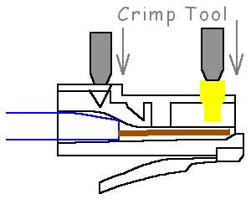
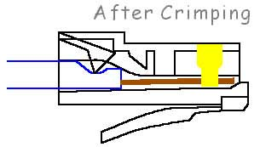
Step 7 - Crimp
Squeeze firmly to crimp connecter onto cable end (8P)

Slide 23
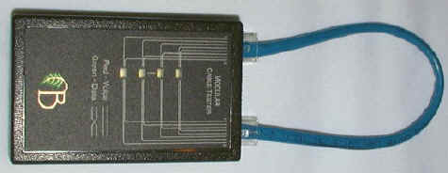
Step 8 – Test
Does the cable work?

Slide 24
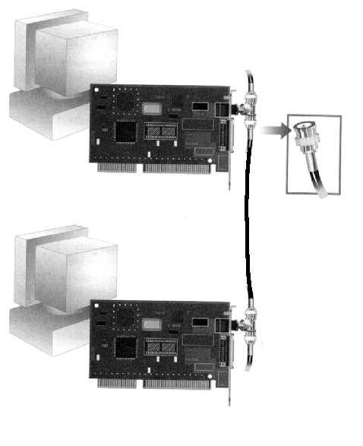
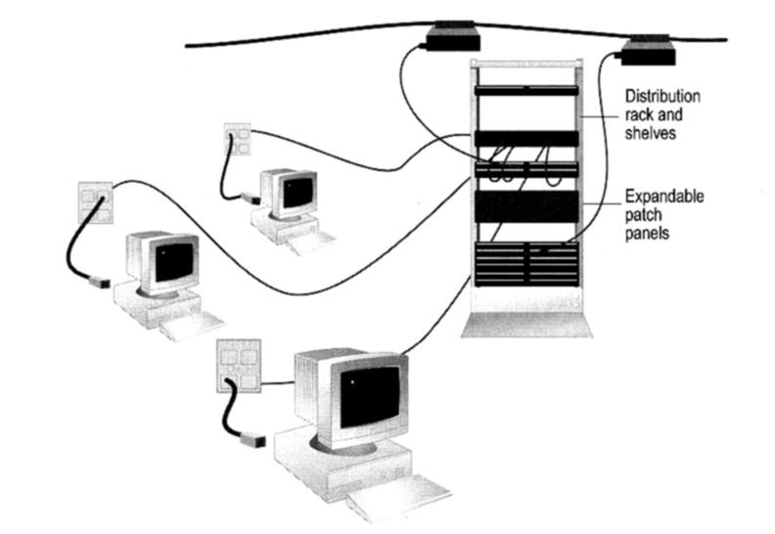
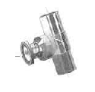
How to construct a network with Bus / Star Topology?
Bus Topology
Coaxial cable
Star Topology
BNC T-Connector
Network Card

Slide 25
Networks building blocks
All networks, large or small, require specialized network hardware to make them work.
Small networks will have less network hardware than large networks.
Small or large, all networks are built from the following basic building blocks:
Client computers
computers that end users use to access the resources of the network.
located on users’ desks.
usually run a desktop version of Windows such as Windows Vista, Windows XP, Ubuntu or Open Suse, along with application soft- ware such as Microsoft Office.
sometimes referred to as workstations.

Slide 26
Cont …
Server computers
Computers that provide shared resources, such as disk storage and printers, as well as network services, such as e-mail and Internet access.
run a specialized net- work operating system such as Windows Server 2008 or 2003, Ubuntu Server, Leopard (OS X) Server along with special software to provide network services.
Network interface card (NIC)
An interface that’s installed in a computer that enables the computer to communicate over a network.
Every client and every server computer must have a NIC in order to be a part of a network.
Cable
Computers in a network are usually physically connected to each other using a cable

Slide 27
Cont …
Switches
Network cable usually doesn’t connect computers directly to each other
Instead, each computer is connected by cable to a device known as a switch
Each switch contains a certain number of ports, typically 8 or 16
Wireless networks
computers to communicate via radio signals
radio transmitters and receivers take the place of cables
main advantage of wireless net- working is its flexibility
main disadvantage of wireless networking is that it is inherently less secure than a cabled network.
Network software
As important as network hardware.
Server computers typically use a special network operating system (also known as a NOS) in order to function efficiently.

Slide 28
Clients and Servers
The network computer that contains the hard drives, printers, and other resources that are shared with other network computers is called a server
Any computer that’s not a server is called a client.
Differences between the two computers:
The most powerful and expensive computers in a network are the servers
every user on the network shares the server’s resources.
The cheaper and less powerful computers in a network are the clients
clients’ resources don’t have to be shared
Most networks have more clients than servers
A network with ten clients can probably get by with one server.

